Slide 1

Alabama Veterans Museum
Presented By John Michael Raimondi and Ben Ward
Sprint 1 Presentation

Slide 2
Project History & Challenges
The museum currently has a database of deceased veterans maintained in Microsoft Access
The Access database has become fragmented over 6 files.
The public facing user interface of the database includes inactive dropdowns and edit boxes, appearing to give the users the ability to modify the records.
The inactive controls also contribute to a cluttered, confusing interface.
If the Access database search is used for a last name with more than one record, the record with the alphabetically first name appears. To navigate to other records, the user must know to use the small forward and backward arrows along the status bar.

Slide 3
Solutions
Converting the database to a relational database using structured query language (SQL) will eliminate the need to save the database using a save dialog and possibly fragmenting it.
We will create two separate applications to use against the database.
The viewer application will be for public use. The goal will be a cleaner, more intuitive interface than the current Access database.
The administrator application will be for museum employee / volunteer use. This will also have a cleaner, more intuitive interface, but will allow record creation and editing.
The new applications will present the user with a list of records if more than one is found, allowing selection rather than opening the first record found.

Slide 4
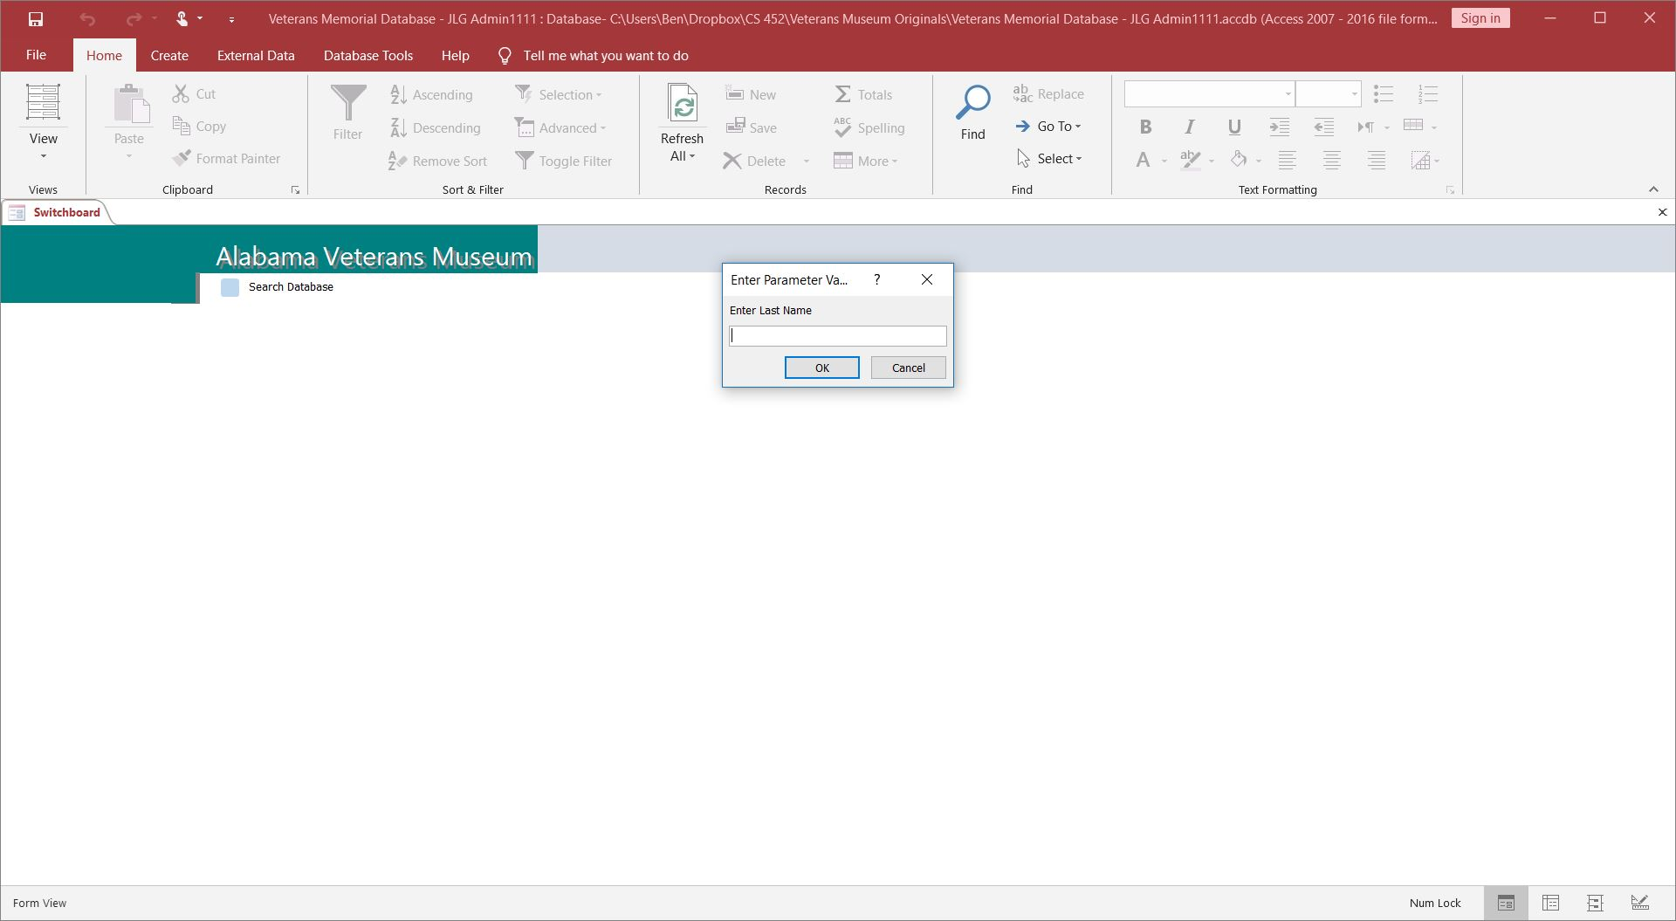
Original Access Search Interface

Slide 5
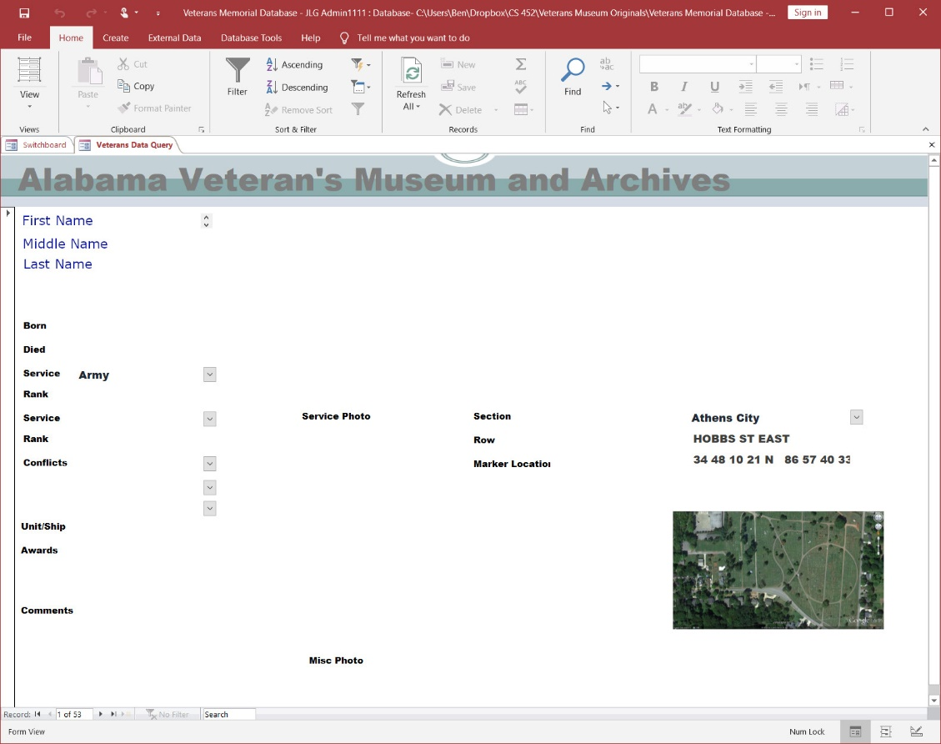
Sample Access Record Result
Note: I modified the first, middle, and last names to anonymize this record.

Slide 6
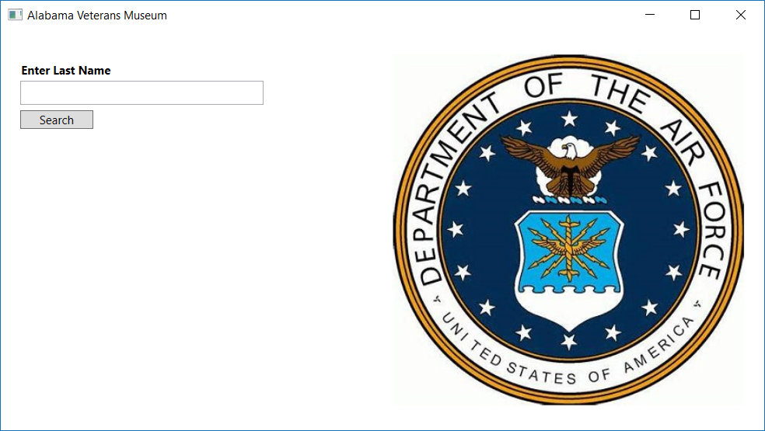
New Client Application Search Window

Slide 7
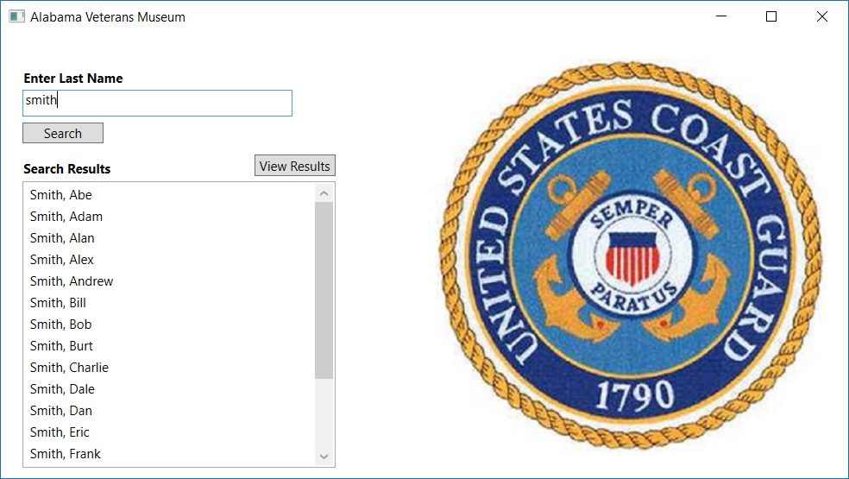
New Client Application Search Window

Slide 8
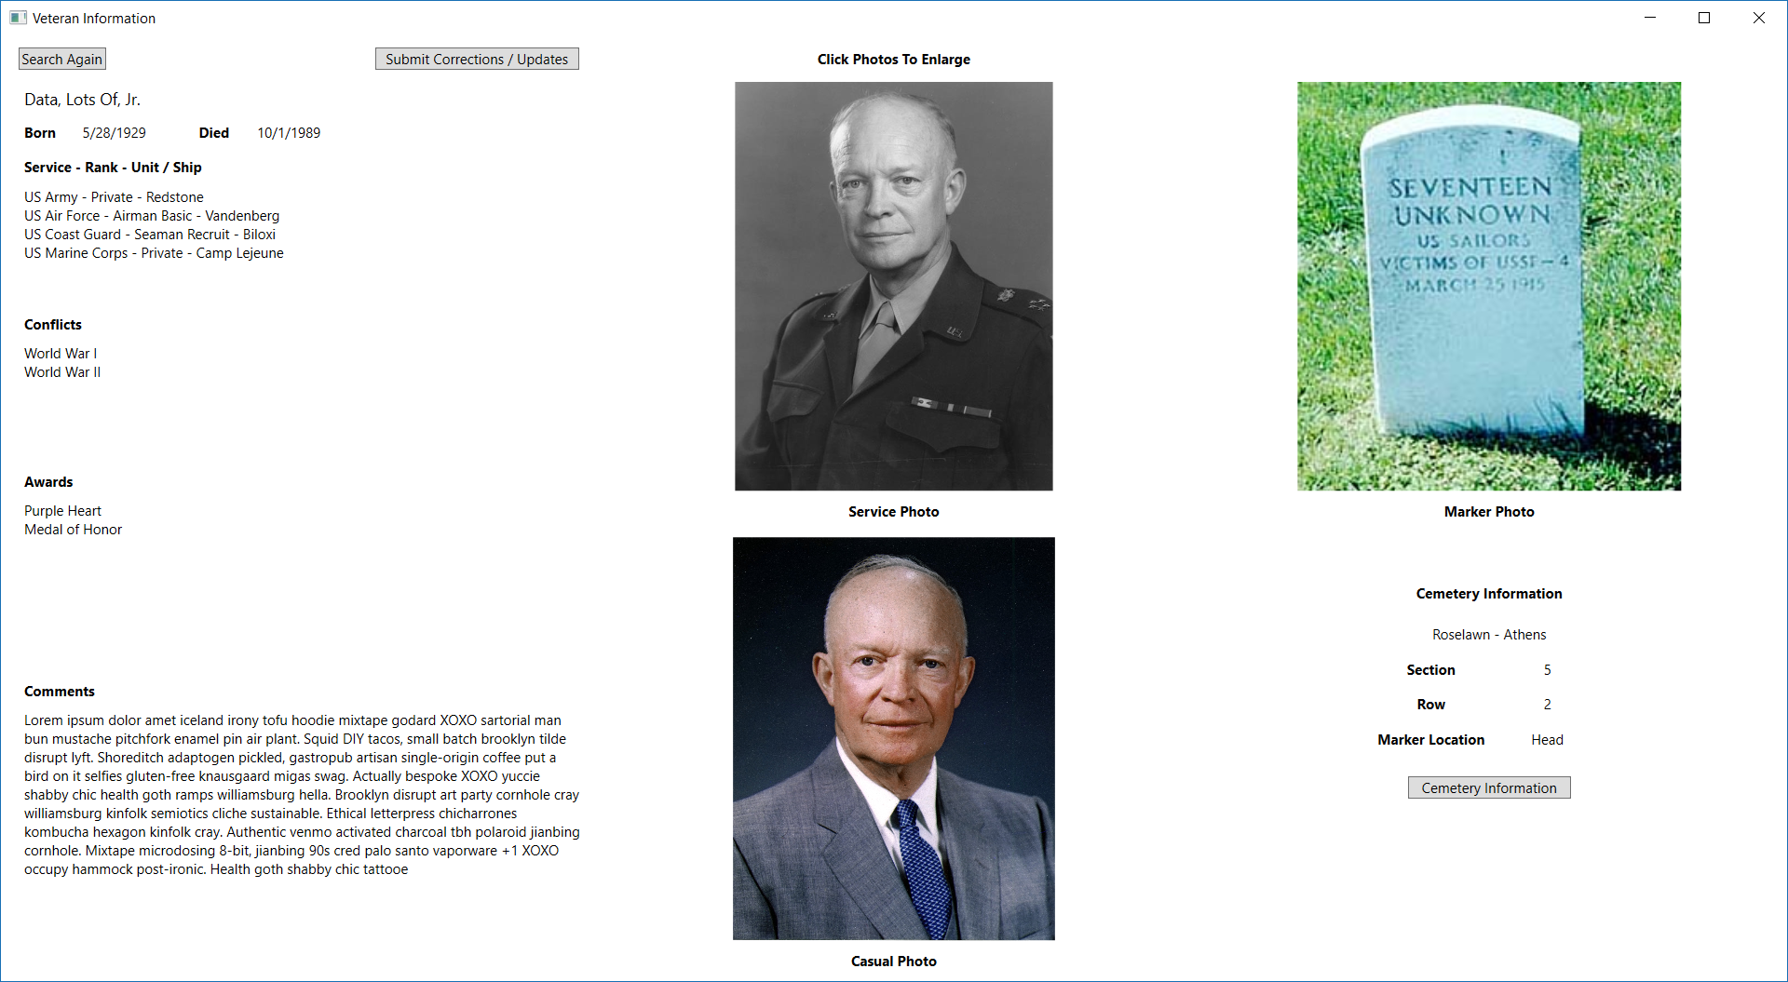
New Client Application Record Window

Slide 9
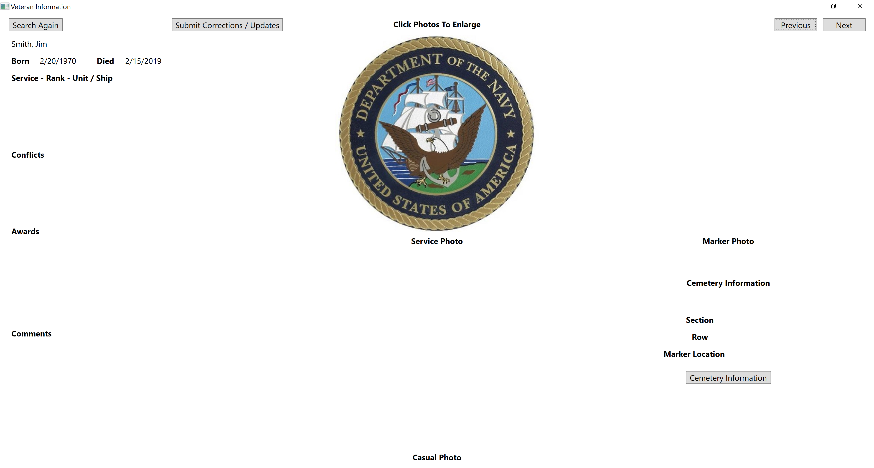
New Client Application Record Window

Slide 10
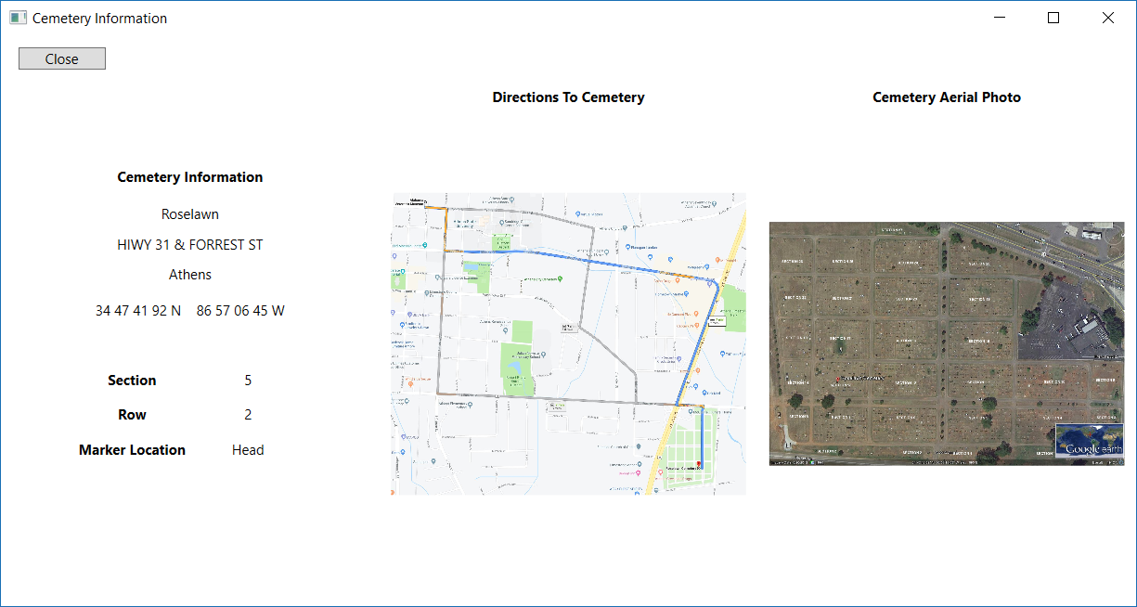
New Client Application Cemetery Info Window

Slide 11
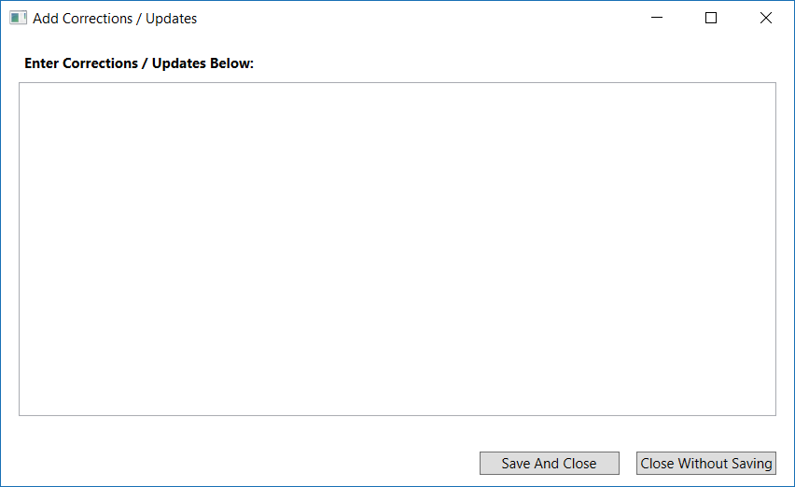
New Client Application User Comments Window

Slide 12
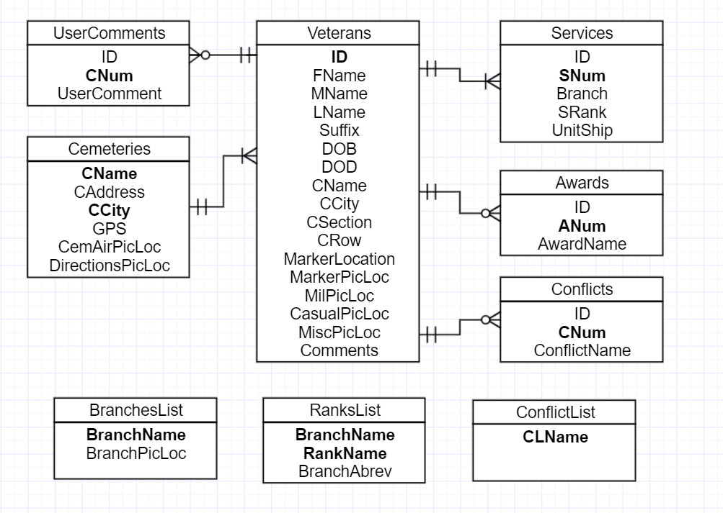
Entity Relationship Diagram

Slide 13

THANK YOU FOR YOUR TIME

